Slide 1
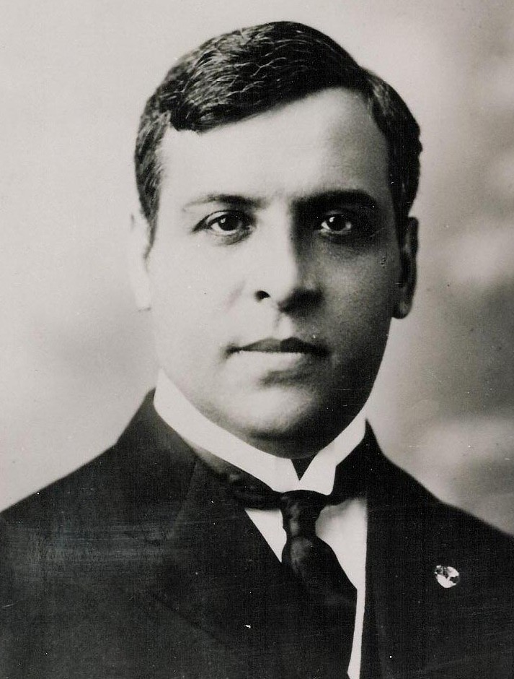
Aristides de Sousa Mendes
By Portuguese Group

Slide 2
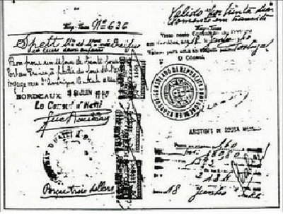
He was a Portuguese diplomat who ignored and disobeyed the orders of his own government for the safety of World War II refugees.
He himself wrote 30,000 visas, thus saving thousands of refugees who were seeking to escape from the Nazi horror; 12,000 of those refugees were Jews.
Visas that Aristides wrote to save the refugees and help them to travel to America

Slide 3
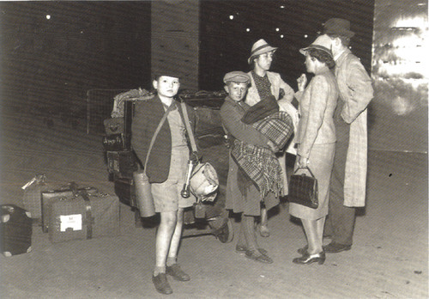
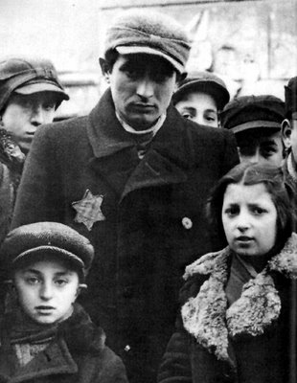
Aristides de Sousa Mendes was “the Portuguese Schindler”; he began his activity on behalf of Jews long before Schindler.
War refugees waiting for Aristides

Slide 4
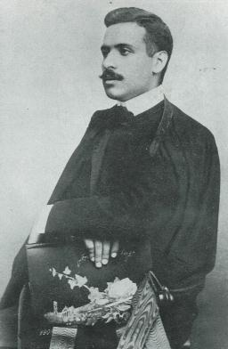
Biography
Aristides de Sousa Mendes do Amaral e Abranches was born on 19th July 1885 and died on 3rd April 1954 in Cabanas de Viriato, near Viseu. He studied Law in the University of Coimbra and then followed the political career. He became a consul in 1910 in Demerara.
Aristides in Coimbra

Slide 5
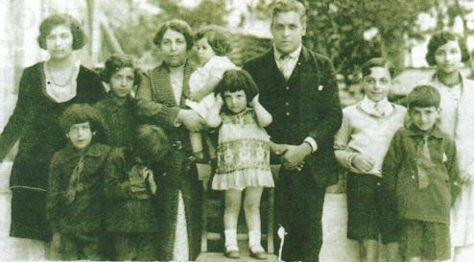
Thousands of World War II refugees who heard about Aristides, his generosity, his charitable work as well as his willingness to help people in trouble, addressed him in Bordeaux, France, where he was a consul, to get his help, because they knew he could emit visas that would allow them to come to Portugal so that they could then take a ship to America.
Aristides’ family

Slide 6
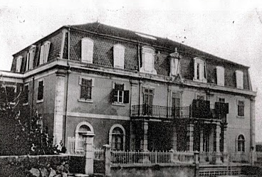
However, this situation became difficult once Portugal was being ruled by a dictator, Salazar, who had forbidden the emission of visas to leave or come to Portugal, for Russians, Portuguese exile politicians and Jews. Although Salazar had imposed that, Aristides continued his mission of saving lives, risking his own life.
Aristides’ house

